Slide 1
Preliminary US-CRS based allocation policy Match Run Analysis
William F Parker, MD PhD
OPTN heart committee leadership meeting 8/11

Slide 2
Match run analysis focuses on the allocation policy in isolation
Re-order historical match runs based on an alternative policy
Easy to implement
Not a full simulation- unable to quantify outcomes

Slide 8
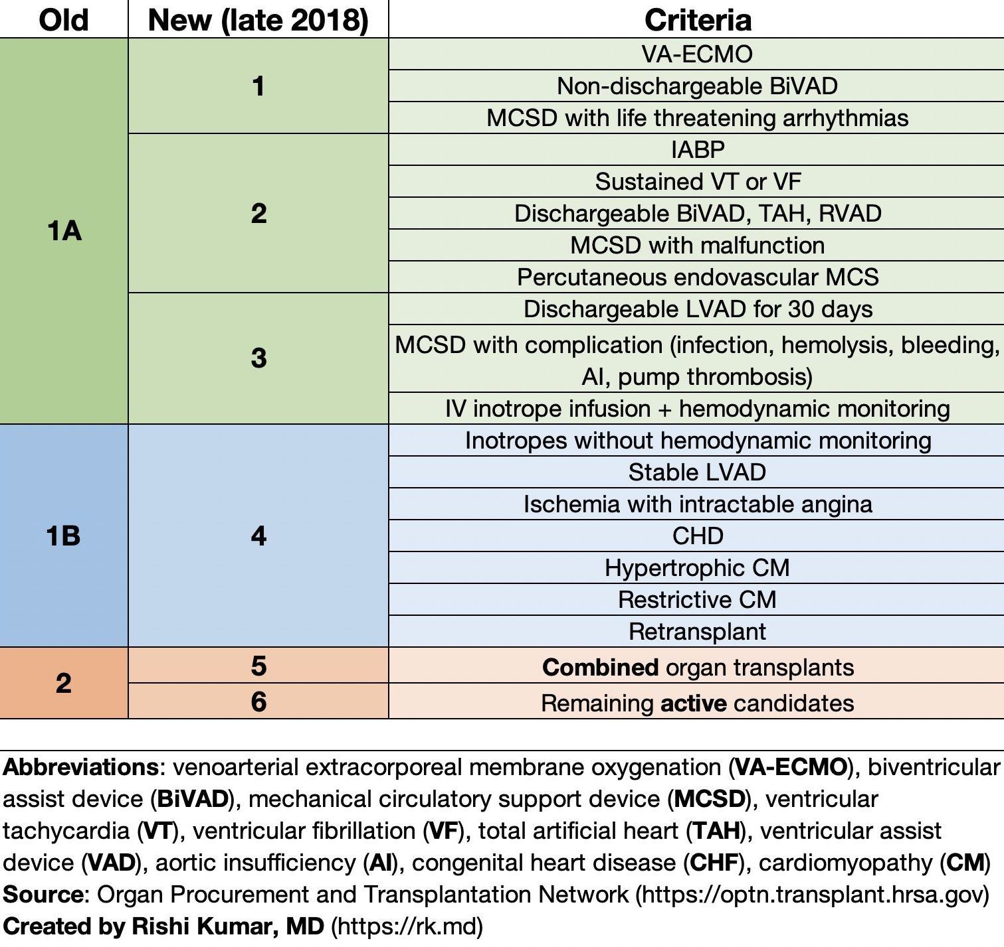
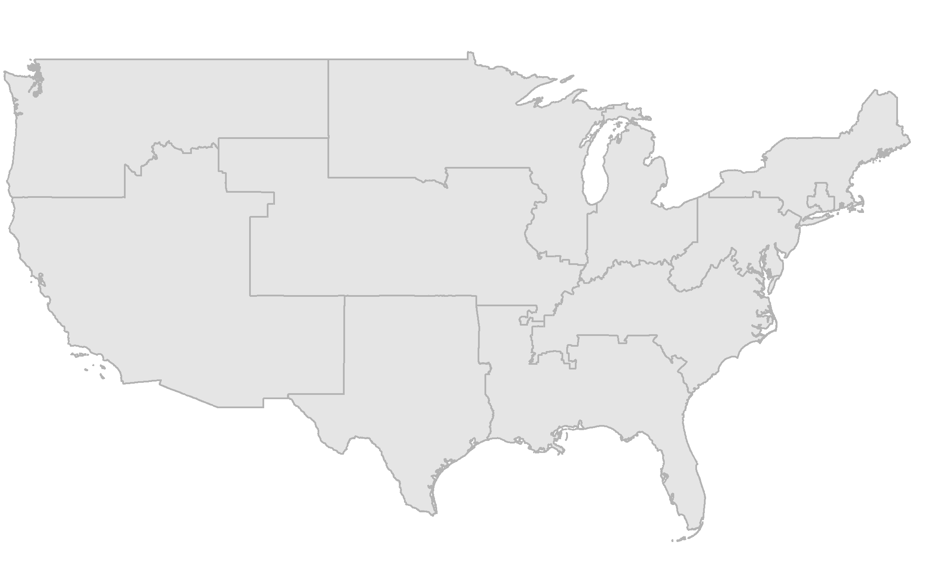
Current US heart allocation policy
Acuity ring-based sharing
6 status categories

Slide 9
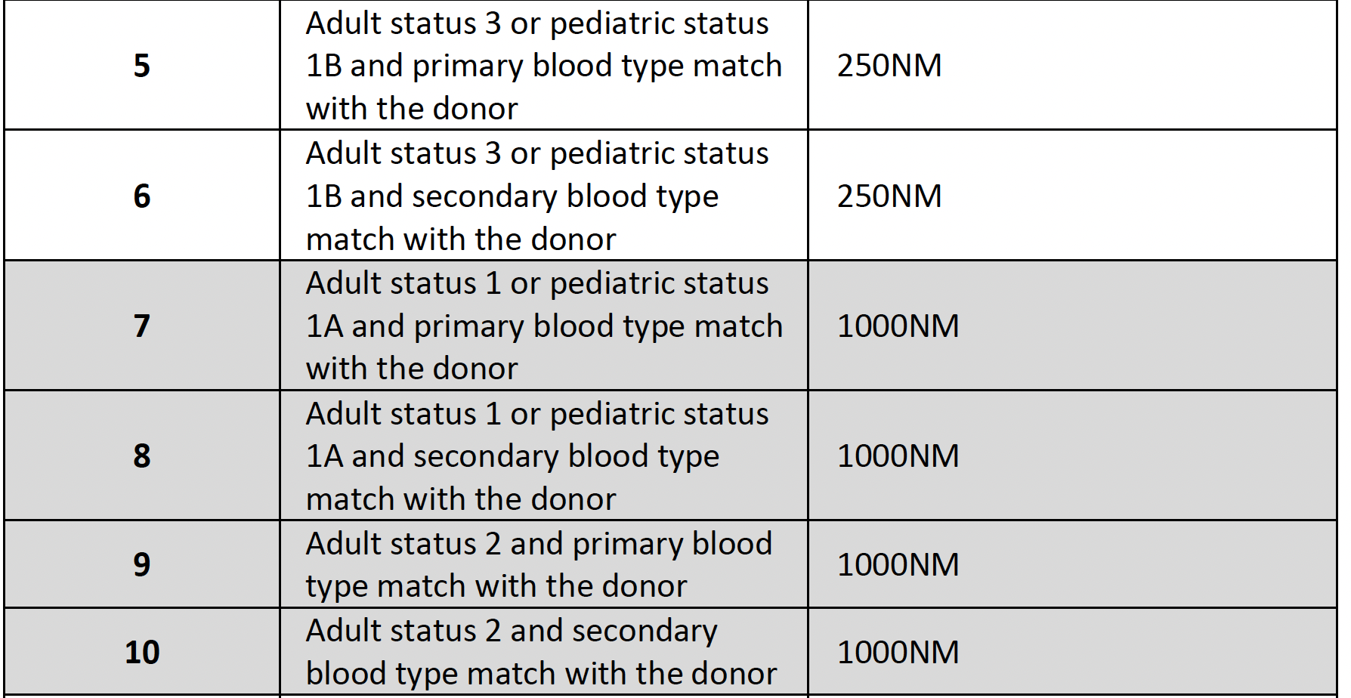
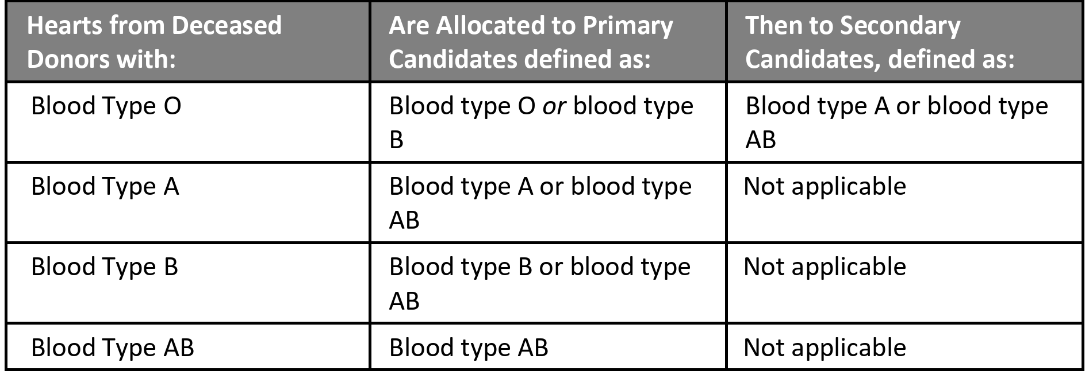
Current 6-status + acuity ring policy
Ties within a classification broken by waiting time
ABO compatibility rules

Slide 10
Converting US-CRS into an allocation policy
Replace the current treatment-based status category with category of US-CRS
Maintain the same ABO compatibility rules, acuity rings, and pediatric priority
Break ties with US-CRS, then waiting time
Status | US-CRS range
Status 1 | ≥49
Status 2 | 40-48
Status 3 | 30-39
Status 4 | 20-29
Status 5 | 10-19
Status 6 | <10

Slide 11
Replace treatment based statuses with US-CRS statuses

Slide 12
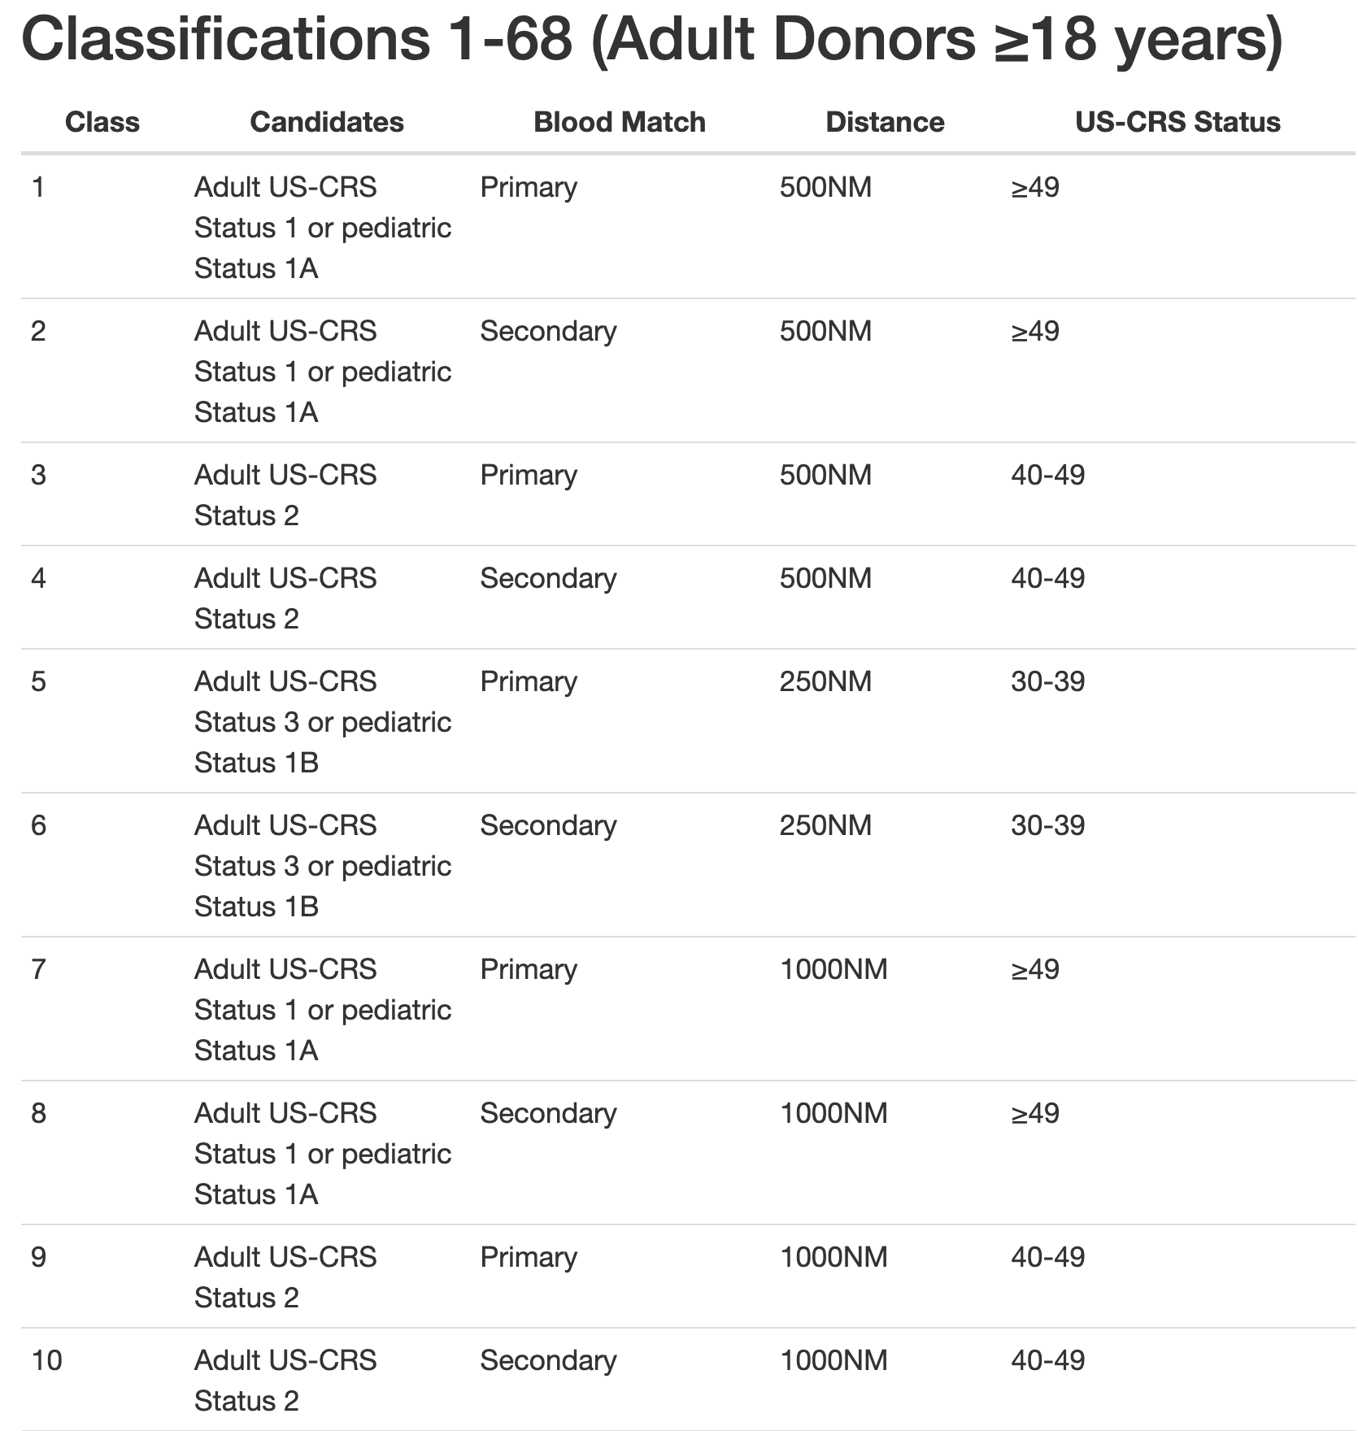
Replace treatment based statuses with US-CRS statuses

Slide 13
Replace treatment based statuses with US-CRS statuses

Slide 14
Methods
Construct US-CRS mapping table from 2019-2021
Calculate US-CRS score at the time of the match run for each candidate in the match run for all match runs that occurred in 2022
Compare observed 6-status system rankings to the national and acuity-circle based US-CRS systems

Slide 15
Match run example- observed

Slide 16
Match run example- observed

Slide 17
Match run: US-crs acuity circles

Slide 18
Match run: US-crs national

Slide 19
Match run example- observed for first 100 patients

Slide 20
US-CRS + acuity first 100 patients

Slide 21
US-CRS: national first 100 patients

Slide 23
Median distance per sequence number is similar for acuity circle + US-CRS vs. 6-status + acuity circle

